Slide 1





CODE
RED
25
CODE TILL YOU DROP...
SOLUTION
OUTLINE
Problem Statement Code: CR01
Team Name: HOUSE OF VOID
Team Leader Name: ANUDAY SRIVASTAVA
Institution Name: BMS INSTITUTE OF TECHNOLOGY AND MANAGEMENT

Slide 2
Carbon Grove: Rewarding Sustainability By Personalized Digital Gardens and Real-World Impact
The Problem:
Carbon Footprint Reduction: Tracking and reducing personal environmental impact is a major challenge.
Waste Mismanagement: Frequently organic waste is dumped instead of being composted for farming.
Energy Misuse: Lack of incentives for people to save energy in households.
Access to Organic Products: In some regions organic fruits and vegetables are expensive and not accessible.
Our Solution
Carbon Grove is an intuitive soluton that benefits and guides users to take up eco-friendly activities by:
Rewarding Energy Conservation: Users can upload their electricity bills inorder to track energy consumption and earn points for lowering their monthly usage.
Handing out Household Organic Waste : Users can hand out household waste to partnered associations for composting to gain extra points.
Personalized Digital Gardens: Points are used to grow virtual Fruits, vegetables and plants in a gamified garden.
Effect in the Real-World: Fruits and vegetables are delivered to user as planted in the virtual garden and the household waste is composted for organic farming .
Creating Awareness among users
A gamified approach to increase alertness on personal carbon footprint reduction.
Its Working
And Its Use Cases
Households:
Helps in recycling of waste, reducing the energy consumption, and enjoy fresh, organic fruits and vegetables.
Communities:
We focus on connecting users with local organic farms and waste management programs by promoting collective sustainability actions.
Corporate and NGO Partnerships:
Businesses can reward eco-friendly behaviour by enabling CSR prgrams.
Eco-Friendly Actions
Garden Growth
Energy Saving
Composting
Earn Points
Virtual Garden
Garden Growth
Organic Produce
Community Share
Leaderboards

Slide 3















Show Stopper and your Dependencies Technology Stack
DEPENDENCY ON PARTNERSHIPS: Joining hands with NGOs, organic farming groups and waste management groups is very important to make the app work correctly and smoothly.
ACCURACY OF CARBON FOOTPRINT CALCULATION : We have to make sure that the carbon footprints are calculated properly from the electricity bills in order to earn and maintain the trust of the users.
CHALLENGES IN OPERATION AND REGULATION: Managing distribution and collection as well as regulating point redemption system along with keeping the data privacy policies in check.
USER UPTAKE AND RETENTION:Ensuring user interest which requires engaging rewards, smooth experiences, and motivation to log inorder to perform eco-friendly actions regularly.

Slide 4
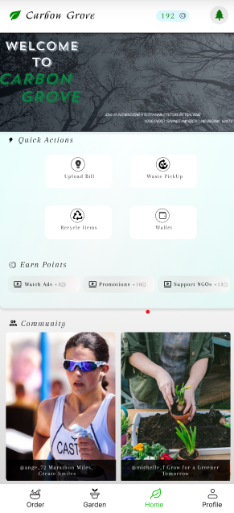
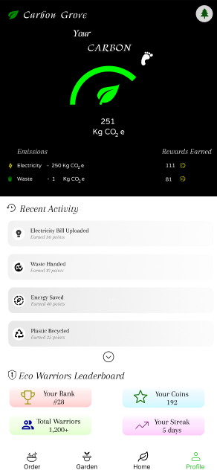
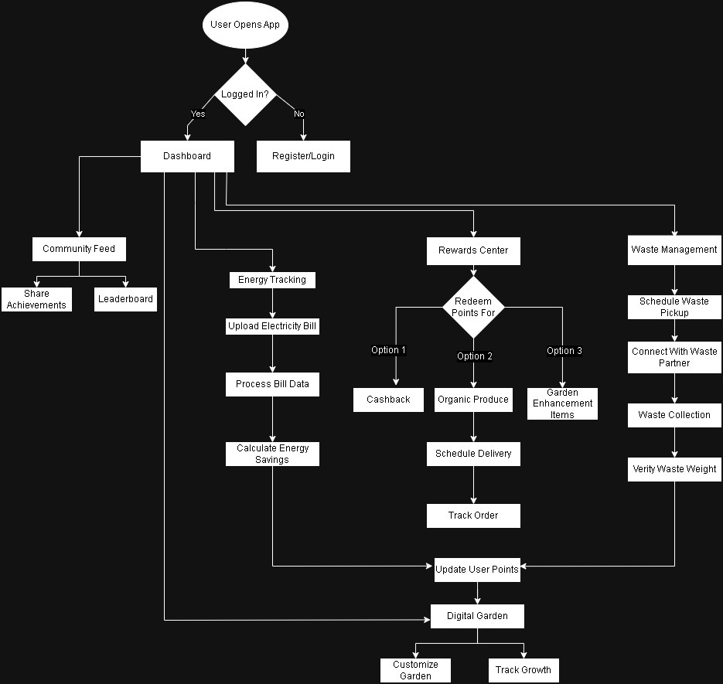
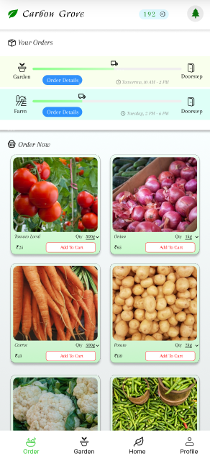
FLOWCHART & DESIGN
Click here to visit our website!!!

Slide 5
TEAM DETAILS
Team Leader Name: ANUDAY SRIVASTAVA
Student ID: 1BY22CS023
Institution Name: BMS INSTITUTE OF TECHNOLOGY AND MANAGEMENT
Phone Number: 8073408064
Email ID: Srivastava061025@gmail.com
Member 1 Name : SWITHIN FERNANDES
Member 2 Name : DHRUV C SHETTY
Member 3 Name : VANSHAM BHATIA

